Slide 1
Biostatistics for RNA-seq analysis
Day 1 - Morning session
Introduction to Probability and Statistics

Slide 2
Overview
Primer on Probability
Random variables
Continuous and discrete distributions
RNAseq counts are inherently discrete
Parameters of a distribution
Estimation and hypothesis testing
Estimation of parameters
Inference using the t-test and p-values
Multiple testing procedures
Bonferroni correction
Controlling the False Discovery Rate
R examples

Slide 3
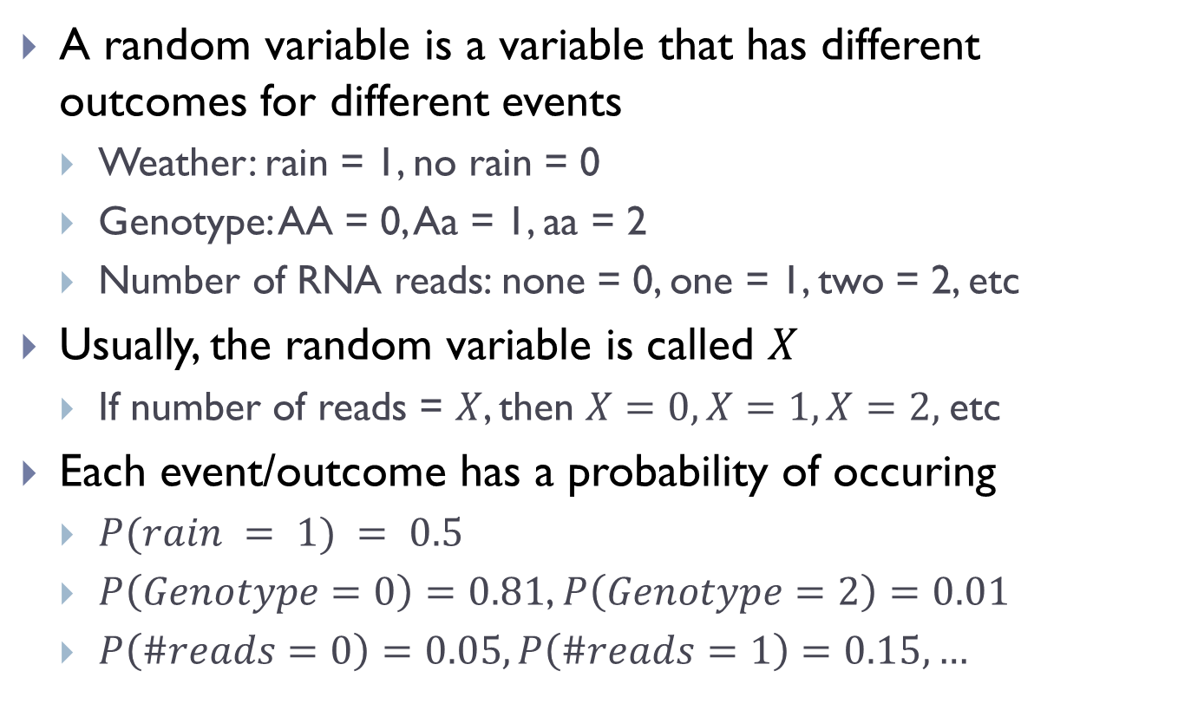
What is a random variable
A random variable is a variable that has different outcomes for different events
Weather: rain = 1, no rain = 0
Genotype: AA = 0, Aa = 1, aa = 2
Number of RNA reads: none = 0, one = 1, two = 2, etc
Usually, the random variable is called $X$
If number of reads = $X$, then $X=0, X=1, X=2,$etc
Each event/outcome has a probability of occuring
$P(rain = 1) = 0.5$
$P\left(Genotype=0\right)=0.81$, $P\left(Genotype=2\right)=0.01$
$P\left(\#reads=0\right)=0.05, P\left(\#reads=1\right)=0.15,…$

Slide 4
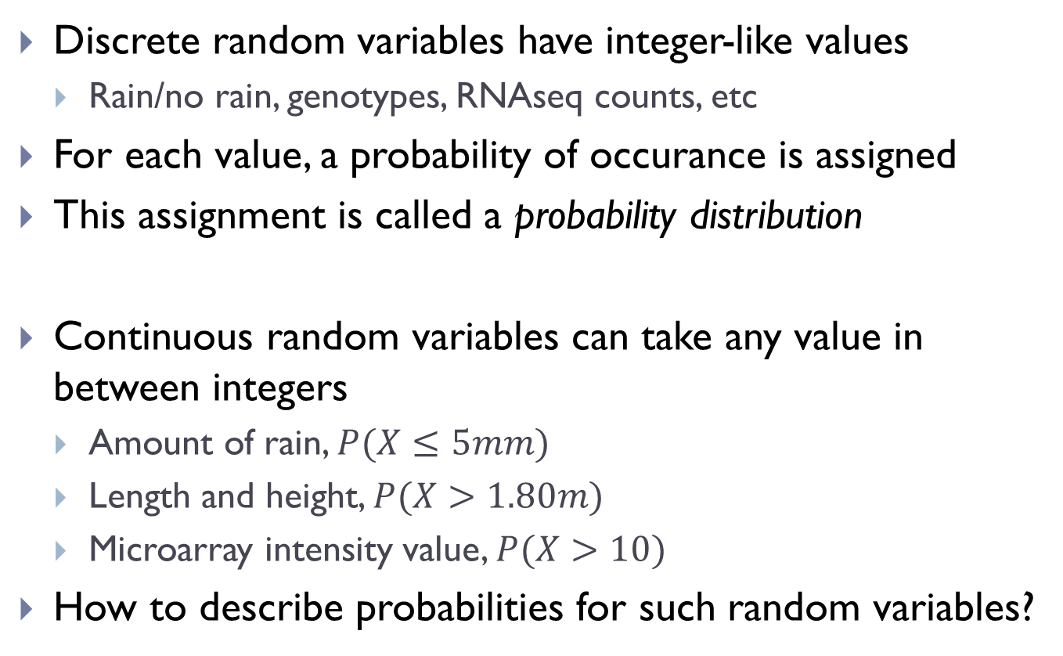
Continuous vs discrete RVs
Discrete random variables have integer-like values
Rain/no rain, genotypes, RNAseq counts, etc
For each value, a probability of occurance is assigned
This assignment is called a probability distribution
Continuous random variables can take any value in between integers
Amount of rain, $P(X≤5mm)$
Length and height, $P(X>1.80m)$
Microarray intensity value, $P(X>10)$
How to describe probabilities for such random variables?

Slide 5
Several often-used distributions
Several popular continuous distributions
Normal/Gaussian
Uniform
Exponential
And discrete distributions
Binomial
Poisson
Negative-binomial

Slide 6
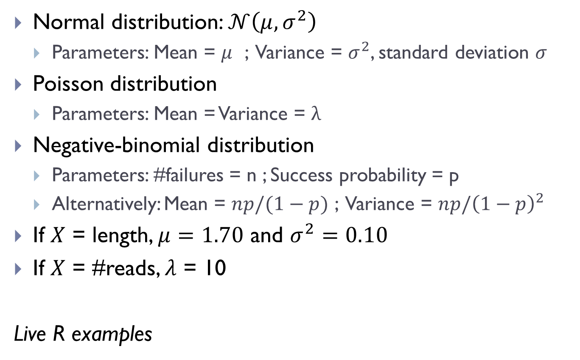
Parameters of distributions
Normal distribution: $𝒩\left(μ,σ^{2}\right)$
Parameters: Mean = $μ$ ; Variance = $σ^{2}$, standard deviation $σ$
Poisson distribution
Parameters: Mean = Variance = $λ$
Negative-binomial distribution
Parameters: #failures = n ; Success probability = p
Alternatively: Mean = $np/(1−p)$ ; Variance = $np/{\left(1−p\right)}^{2}$
If $X$ = length, $μ=1.70$ and $σ^{2}=0.10$
If $X$ = #reads, $λ$ = 10
Live R examples

Slide 7
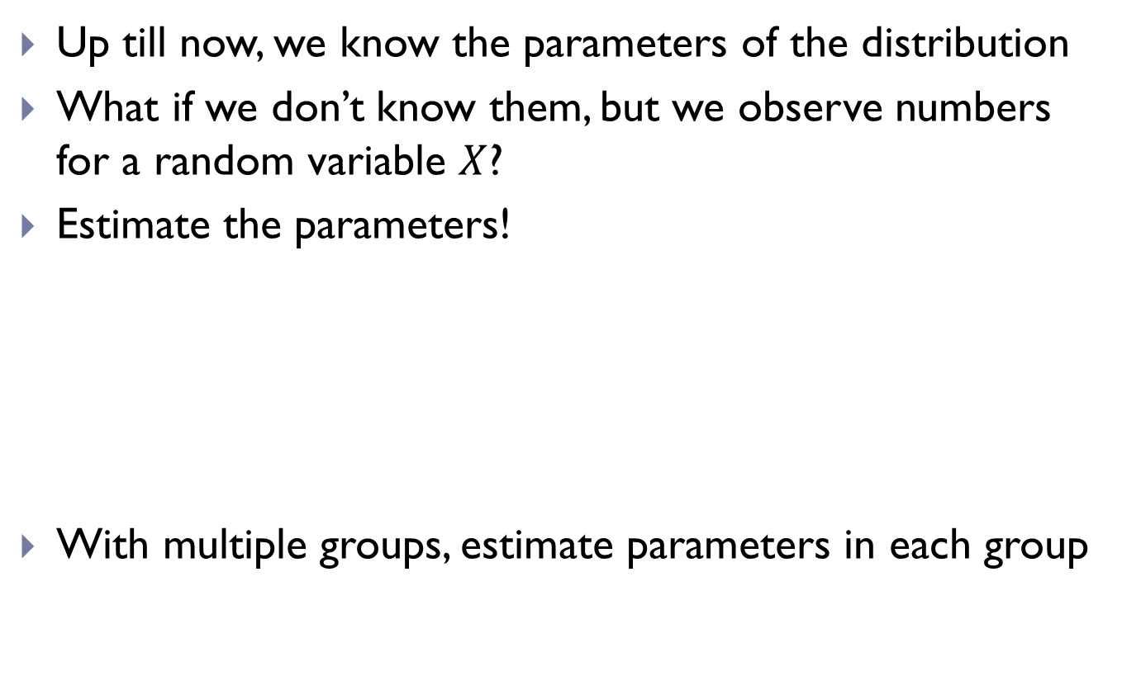
Estimation
Up till now, we know the parameters of the distribution
What if we don’t know them, but we observe numbers for a random variable $X$?
Estimate the parameters!
With multiple groups, estimate parameters in each group
 |  |  | Mean | Variance
1,76 | 1,74 | 1,87 | 1,79 | 0,005
10 | 9 | 5 | 8 | -
Notes:
1.76, 1.74, 1.87 => 1.8, 0.1
10, 9, 5 => 10

Slide 8
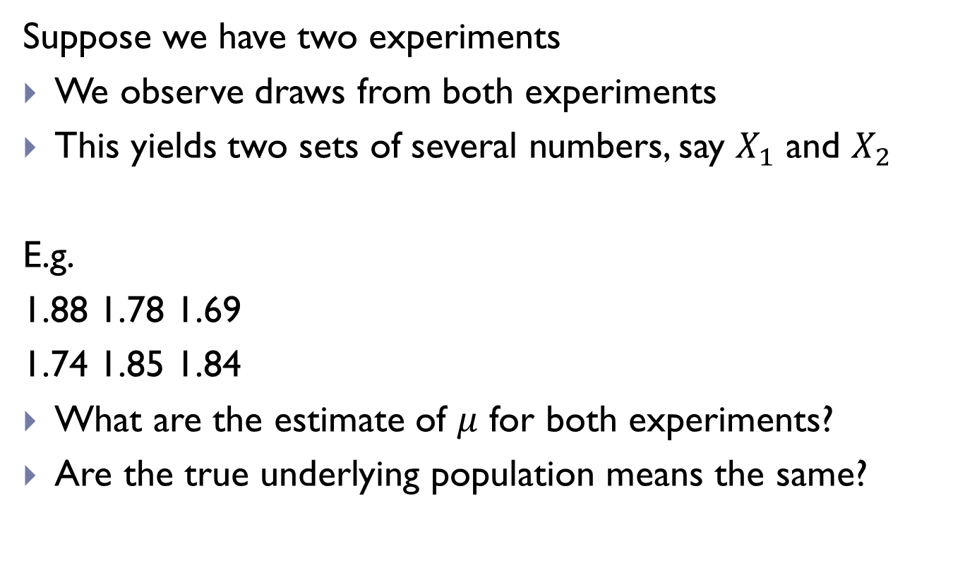
Testing hypotheses
Suppose we have two experiments
We observe draws from both experiments
This yields two sets of several numbers, say $X_{1}$ and $X_{2}$
E.g.
1.88 1.78 1.69
1.74 1.85 1.84
What are the estimate of $μ$ for both experiments?
Are the true underlying population means the same?
Notes:
t.test(c(1.84, 1.78, 1.69), c(1.74, 1.85, 1.84))

Slide 9
Testing hypotheses
Sample means are: 1.77 and 1.81
Suppose the true means are different, what can be an explanation for the observed sample mean difference?
Suppose the true means are the same, what can be an explanation for the observed sample mean difference?

Slide 10
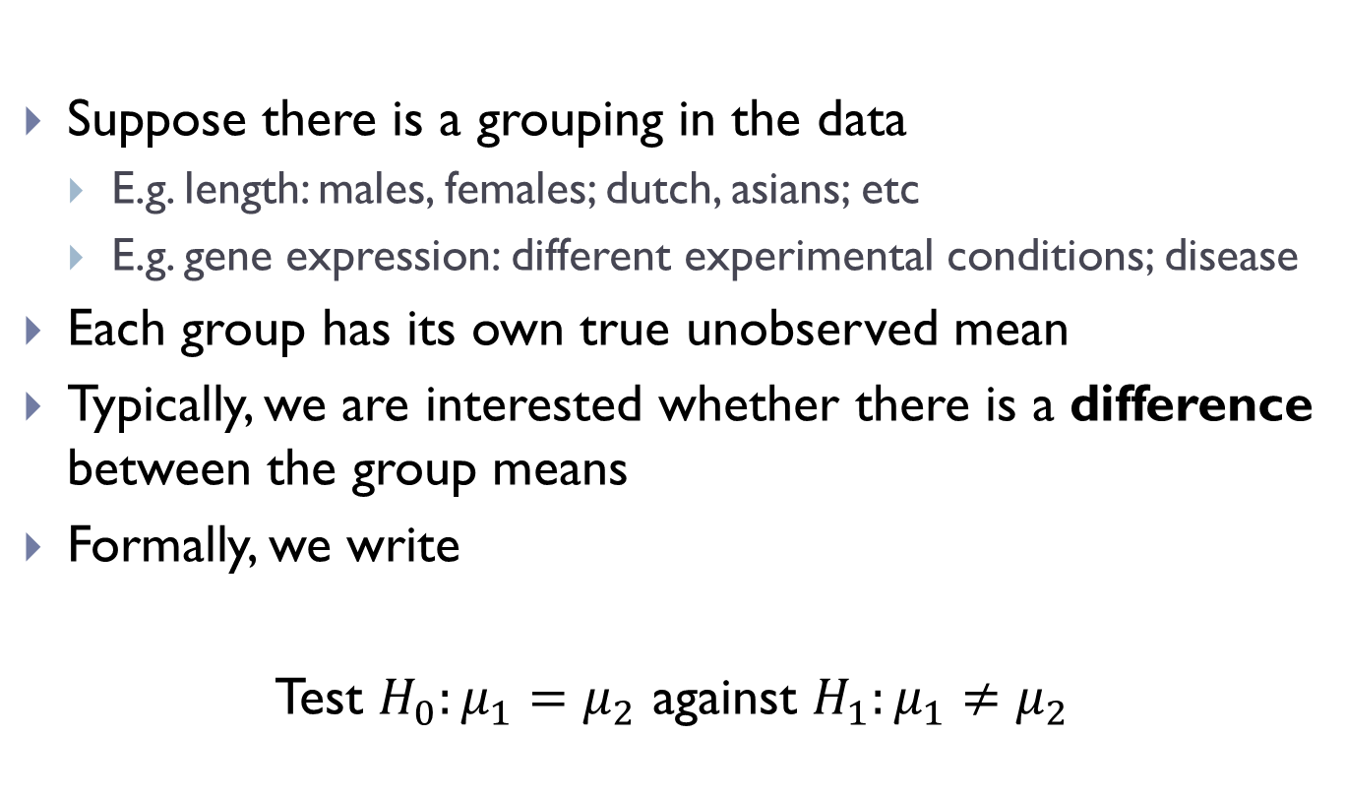
Testing hypotheses
Suppose there is a grouping in the data
E.g. length: males, females; dutch, asians; etc
E.g. gene expression: different experimental conditions; disease
Each group has its own true unobserved mean
Typically, we are interested whether there is a difference between the group means
Formally, we write
Test $H_{0}:μ_{1}=μ_{2}$ against $H_{1}:μ_{1}≠μ_{2}$

Slide 11
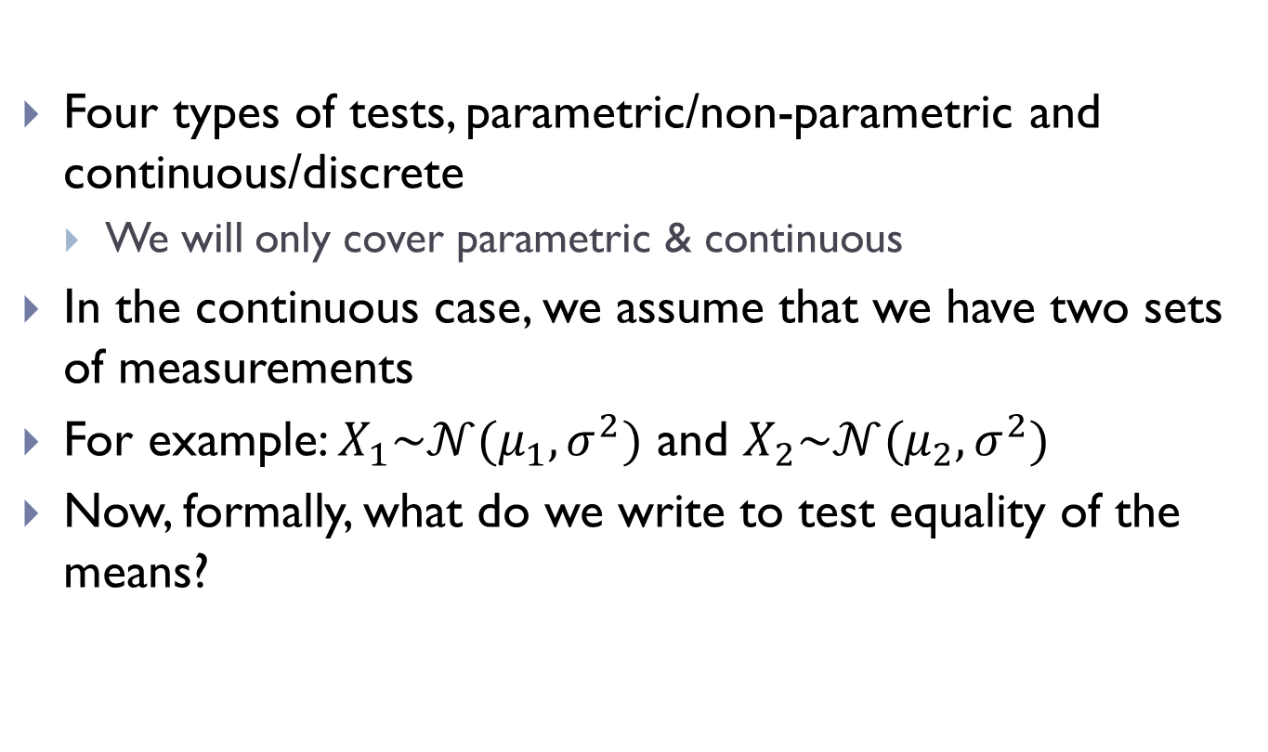
Testing hypotheses (continuous)
Four types of tests, parametric/non-parametric and continuous/discrete
We will only cover parametric & continuous
In the continuous case, we assume that we have two sets of measurements
For example: $X_{1}\sim 𝒩(μ_{1},σ^{2})$ and $X_{2}\sim 𝒩(μ_{2},σ^{2})$
Now, formally, what do we write to test equality of the means?

Slide 12
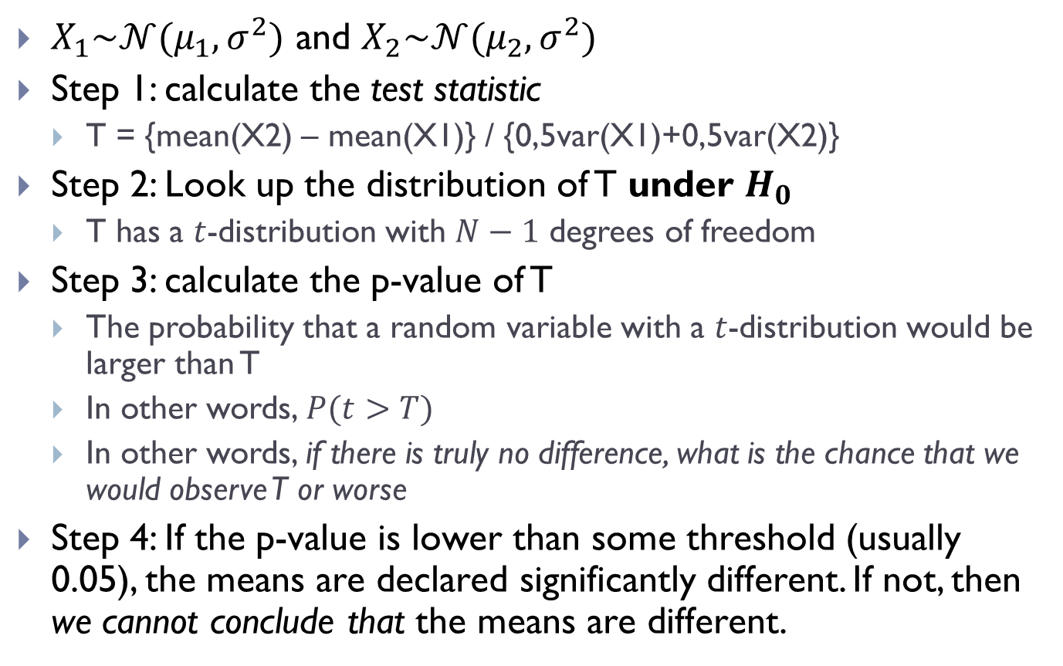
Testing hypotheses (t test)
$X_{1}\sim 𝒩(μ_{1},σ^{2})$ and $X_{2}\sim 𝒩(μ_{2},σ^{2})$
Step 1: calculate the test statistic
T = {mean(X2) – mean(X1)} / {0,5var(X1)+0,5var(X2)}
Step 2: Look up the distribution of T under $H_{0}$
T has a $t$-distribution with $N−1$ degrees of freedom
Step 3: calculate the p-value of T
The probability that a random variable with a $t$-distribution would be larger than T
In other words, $P(t>T)$
In other words, if there is truly no difference, what is the chance that we would observe T or worse
Step 4: If the p-value is lower than some threshold (usually 0.05), the means are declared significantly different. If not, then we cannot conclude that the means are different.

Slide 13
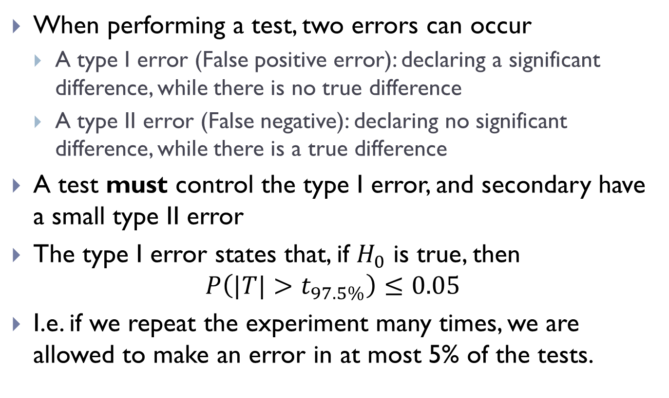
Type I and II errors
When performing a test, two errors can occur
A type I error (False positive error): declaring a significant difference, while there is no true difference
A type II error (False negative): declaring no significant difference, while there is a true difference
A test must control the type I error, and secondary have a small type II error
The type I error states that, if $H_{0}$ is true, then
$$P\left(|T|>t_{97.5\%}\right)≤0.05$$
I.e. if we repeat the experiment many times, we are allowed to make an error in at most 5% of the tests.

Slide 14
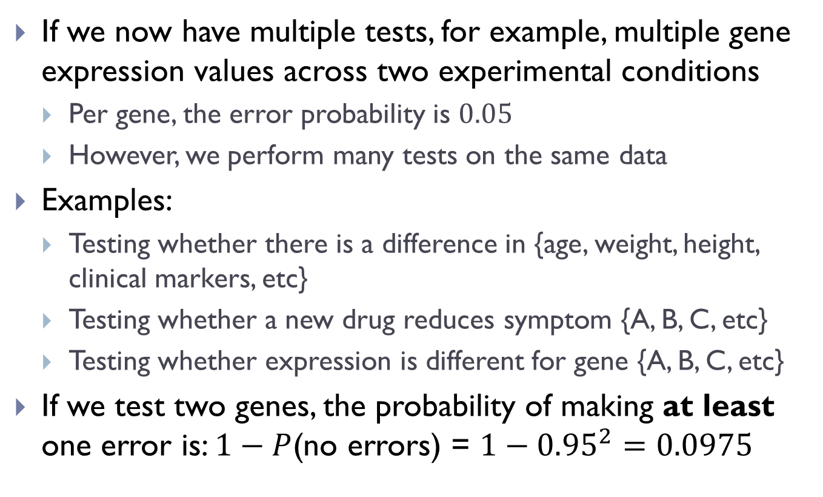
Testing multiple hypotheses
If we now have multiple tests, for example, multiple gene expression values across two experimental conditions
Per gene, the error probability is $0.05$
However, we perform many tests on the same data
Examples:
Testing whether there is a difference in {age, weight, height, clinical markers, etc}
Testing whether a new drug reduces symptom {A, B, C, etc}
Testing whether expression is different for gene {A, B, C, etc}
If we test two genes, the probability of making at least one error is: $1−P$(no errors) = $1−{0.95}^{2}=0.0975$

Slide 15
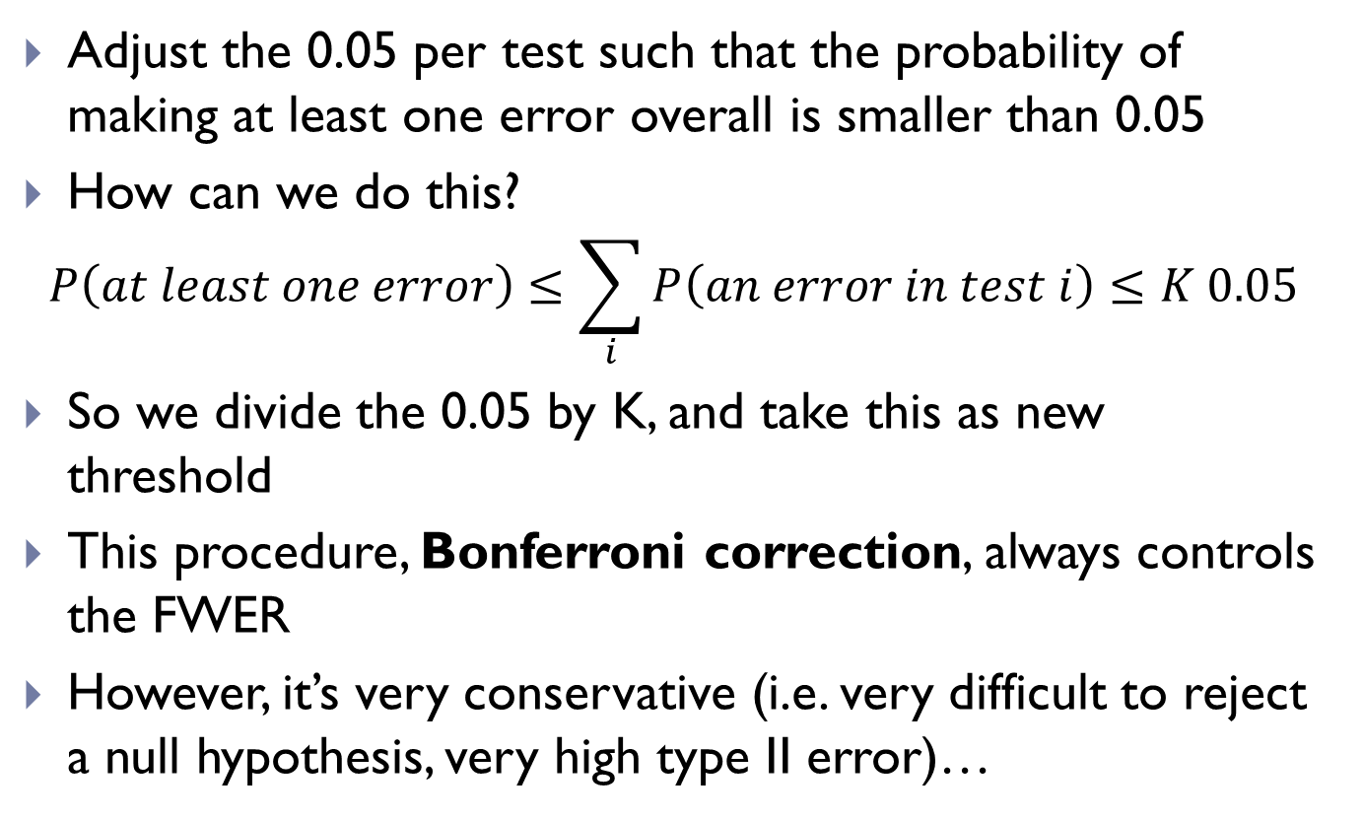
Controlling the Family-wise error rate
Adjust the 0.05 per test such that the probability of making at least one error overall is smaller than 0.05
How can we do this?
$$P\left(at least one error\right)≤\sum_{i}{P\left(an error in test i\right)}≤K 0.05$$
So we divide the 0.05 by K, and take this as new threshold
This procedure, Bonferroni correction, always controls the FWER
However, it’s very conservative (i.e. very difficult to reject a null hypothesis, very high type II error)…

Slide 16
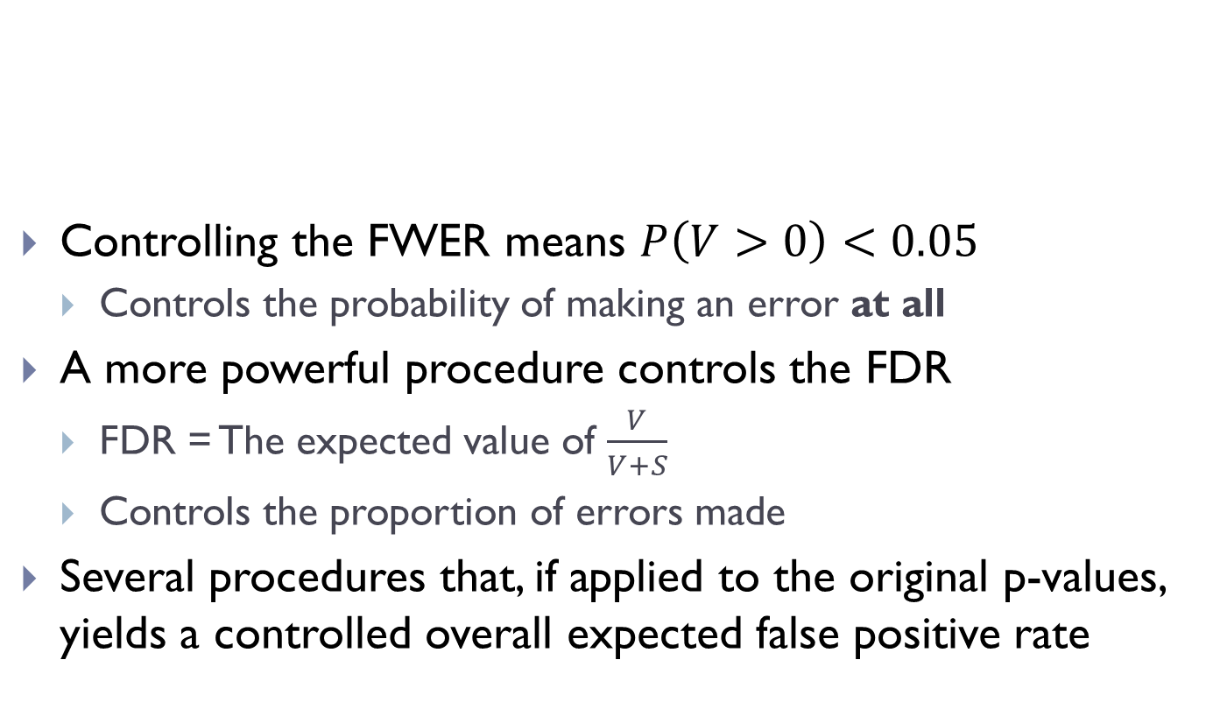
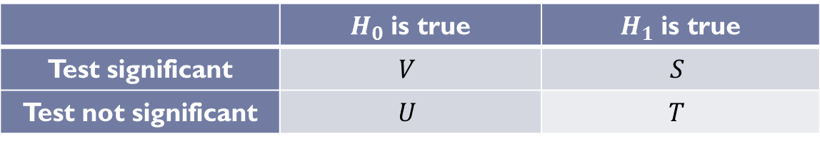
Controlling the False Discovery Rate
Controlling the FWER means $P\left(V>0\right)<0.05$
Controls the probability of making an error at all
A more powerful procedure controls the FDR
FDR = The expected value of $\frac{V}{V+S}$
Controls the proportion of errors made
Several procedures that, if applied to the original p-values, yields a controlled overall expected false positive rate
 | $H_{0}$ is true | $H_{1}$ is true
Test significant | $$V$$ | $$S$$
Test not significant | $$U$$ | $$T$$

Slide 17
Summary
Primer on Probability
Random variables
Continuous and discrete distributions
RNAseq counts are inherently discrete
Parameters of a distribution
Estimation and hypothesis testing
Estimation of parameters
Inference using the t-test and p-values
Multiple testing procedures
Bonferroni correction
Controlling the False Discovery Rate

